Slide 1
Problema
S= X + 3
X

Slide 2
Supor uma saída em 4 bits
Números Positivos
S= X + 3
X
S

Slide 3
Tabela
L | x3 | x2 | x1 | x0 | S | s3 | xs2 | s1 | s0
0 | 0 | 0 | 0 | 0 | 3 |  |  | 1 | 1
1 | 0 | 0 | 0 | 1 | 4 |  | 1
2 |  |  |  |  | 5 |  | 1 |  | 1
3 |  |  |  |  | 6 |  | 1 | 1
4 |  |  |  |  | 7 |  | 1 | 1 | 1
5 |  |  |  |  | 8 | 1
6 |  |  |  |  | 9 | 1 |  |  | 1
7 |  |  |  |  | 10 | 1 |  | 1
8 |  |  |  |  | 11 | 1 |  | 1 | 1
9 |  |  |  |  | 12 | 1 | 1
10 |  |  |  |  | 13 | 1 | 1 |  | 1
11 |  |  |  |  | 14 | 1 | 1 | 1
12 |  |  |  |  | 15 | 1 | 1 | 1 | 1
13 |  |  |  |  | - | x | x | x | x
14 |  |  |  |  | - | x | x | x | x
15 |  |  |  |  | - | x | x | x | x
S3=5,...,12
S2=1,2,3,4
9,10,11,12
S1=0,3,4,7,8,11
12
s0=0,2,4,6,8,10,12
X = don't care

Slide 4
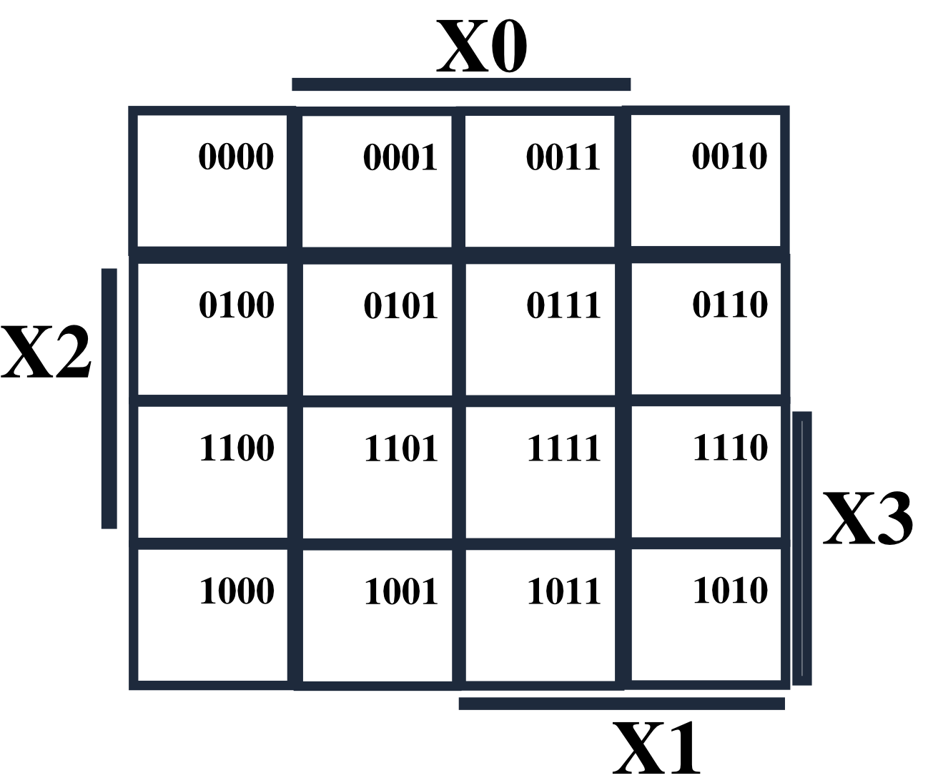
Mapa
S3=5,...,12
S2=1,2,3,4
9,10,11,12
S1=0,3,4,7,8,11
12
s0=0,2,4,6,8,10,12

Slide 5
Tabela
S3=5,...,12
S2=1,2,3,4
9,10,11,12
S1=0,3,4,7,8,11
12
s0=0,2,4,6,8,10,12
X = don't care

Slide 6
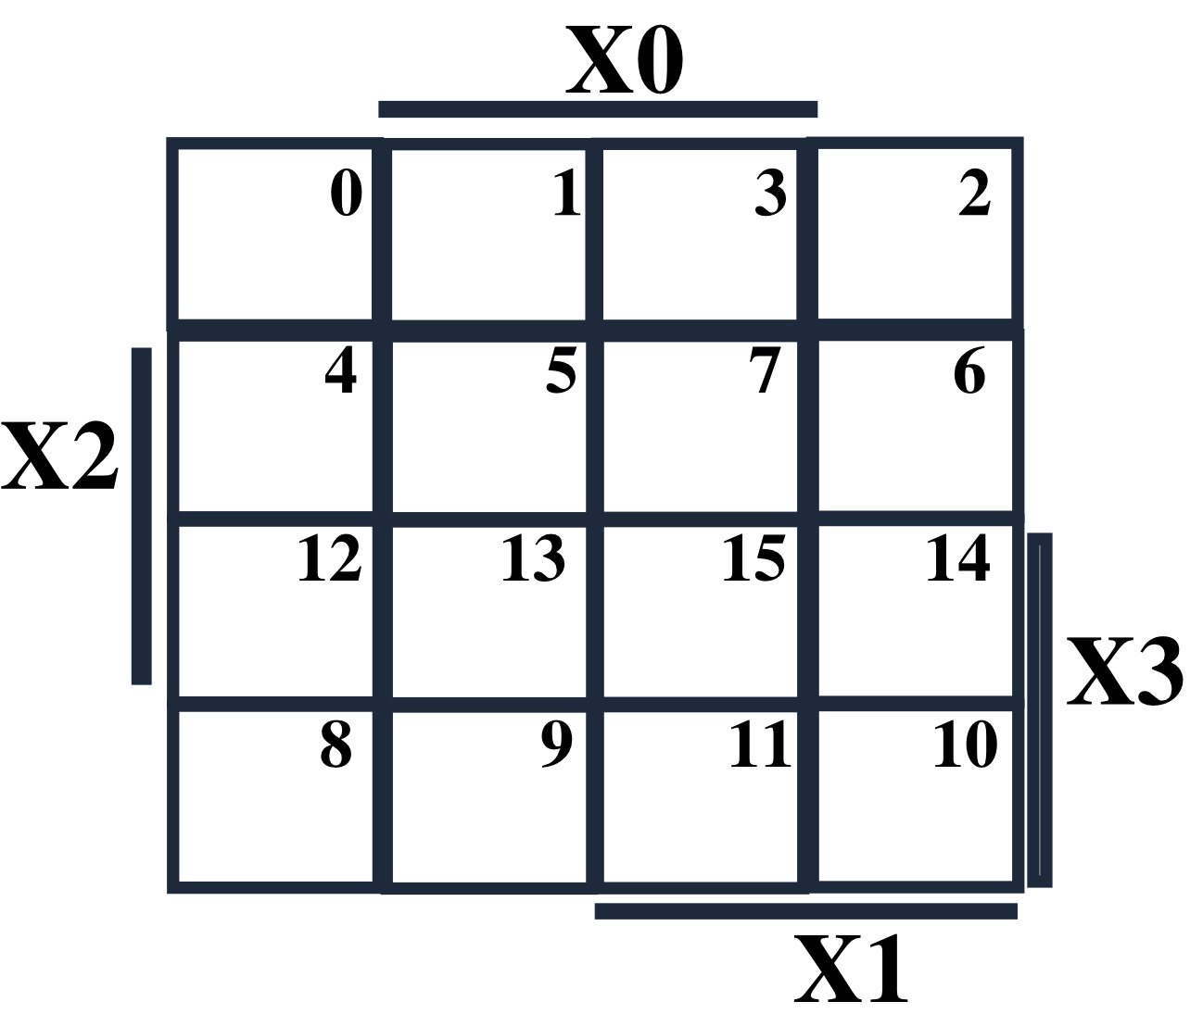
S3=x3 + x2x1+x2x0
S3=5,...,12
S2=1,2,3,4
9,10,11,12
S1=0,3,4,7,8,11
12
s0=0,2,4,6,8,10,12
x2x1
1
1
1
1
x2x0
X
X
X
1
1
1
1
x3

Slide 7
S2=x2!x1!x0+!x2x0+!x2x1
S3=5,...,12
S2=1,2,3,4
9,10,11,12
S1=0,3,4,7,8,11
12
s0=0,2,4,6,8,10,12
1
1
1
1
1
X
X
X
1
1
1
1

Slide 8
S1=!x0!x1+x1x0
S3=5,...,12
S2=1,2,3,4
9,10,11,12
S1=0,3,4,7,8,11
12
s0=0,2,4,6,8,10,12
1
1
1
1
1
X
X
X
1
1
1

Slide 9
S0=!x0
S3=5,...,12
S2=1,2,3,4
9,10,11,12
S1=0,3,4,7,8,11
12
s0=0,2,4,6,8,10,12
1
1
1
1
1
X
X
X
1
1

Slide 10
Teste – Sexta 4/9
S= X * 3
X

Slide 11
Saída – 5 bits
4 bits de entrada → 0 a 15. S*3 → 0 a 45
5 bits → 0 a 31 na Saida
S= X * 3
X

Slide 12
Tabela
L | x3 | x2 | x1 | x0 | S | s4 | s3 | s2 | s1 | s0
0 | 0 | 0 | 0 | 0 | 0
1 | 0 | 0 | 0 | 1 | 3
2 |  |  |  |  | 6
3 |  |  |  |  | 9
4 |  |  |  |  | 12
5 |  |  |  |  | 15
6 |  |  |  |  | 18
7 |  |  |  |  | 21
8 |  |  |  |  | 24
9 |  |  |  |  | 27
10 |  |  |  |  | 30
11 |  |  |  |  | - | x | x | x | x
12 |  |  |  |  | - | x | x | x | x
13 |  |  |  |  | - | x | x | x | x
14 |  |  |  |  | - | x | x | x | x
15 |  |  |  |  | - | x | x | x | x
X = don't care

